Slide 1

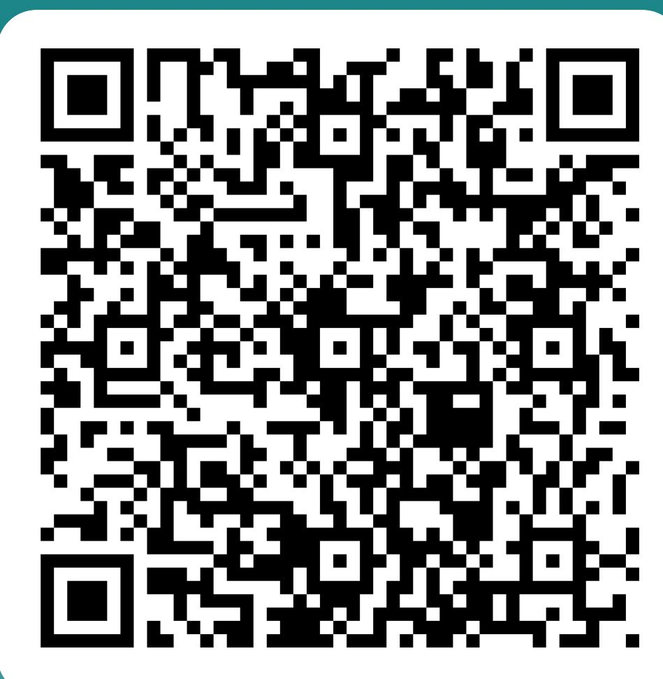

National Grid
Indigenous Peoples Initiative 2024
Indigenous
Peoples
Feedback
Questionnaire
First Nations ERG Mission Statement
2024
Where We Were: One Year Ago
Just a year ago, National Grid was at the nascent stage of our Indigenous engagement and outreach initiatives. At that time, we had not yet established a formal Indigenous Peoples statement, and our presence within Native communities was minimal. There was a need for a foundational approach to understand the unique needs of these communities and to build trust and meaningful relationships. Our early efforts were more reactive than proactive, and we lacked the comprehensive strategy required to make a lasting impact.
Where We Are: Present Achievements
Fast forward to today, and we stand on a much stronger foundation. Over the past year, our commitment to Indigenous engagement has significantly deepened, and our presence has become more pronounced.
Mapping Our Impact: We’ve begun to map our efforts, highlighting the regions and communities where National Grid and tribal territories overlap. These maps serve not only as a visual representation of our reach but also as a strategic tool to identify areas for future growth.
Engaging Through Presentations and Discussions: We’ve conducted several impactful presentations and roundtable discussions, where we shared our initiatives and listened to the voices of Indigenous leaders. These engagements have been crucial in building trust and understanding.
Cultural Participation: Our involvement in Powwows and the Empowering Indigenous Futures Fair has solidified our commitment to being present in the cultural and social spaces that matter most to Native communities. These events have allowed us to connect with community members on a deeper level, celebrating their heritage while also discussing opportunities for collaboration.
Enhanced Visibility: We’ve increased our presence on platforms like LinkedIn, ensuring that our initiatives are visible not just within Native communities but across all sectors where National Grid operates. This visibility has been instrumental in garnering support and fostering partnerships.
Cross-Departmental Collaboration: Our work and collaboration across various departments and ERGS within National Grid has created a more holistic approach to our engagement. This has led to the creation of a comprehensive resource packs that we distribute at events, ensuring that community members have access to essential information.
Growing Interest and Membership: Tribes now actively inviting us into their communities to collaborate on various projects.
Best Practices and Training: We’ve developed best practices for Indigenous outreach and engagement and created a training resources library. These tools are designed to educate our teams on how to engage respectfully and effectively with Native communities.
Emerging Initiatives: Our efforts are in the early phases of launching a dedicated website and have included Traditional Ecological Knowledge (TEK) walks with Chief Earl Mills. We’ve also been involved in key partnerships, such as with the Stockbridge-Munsee Community and at significant events like the Shinnecock and Mashpee Powwows. Additionally, growing our reach into our service territories in New York which reflects our growing influence and leadership in this space.

Slide 2
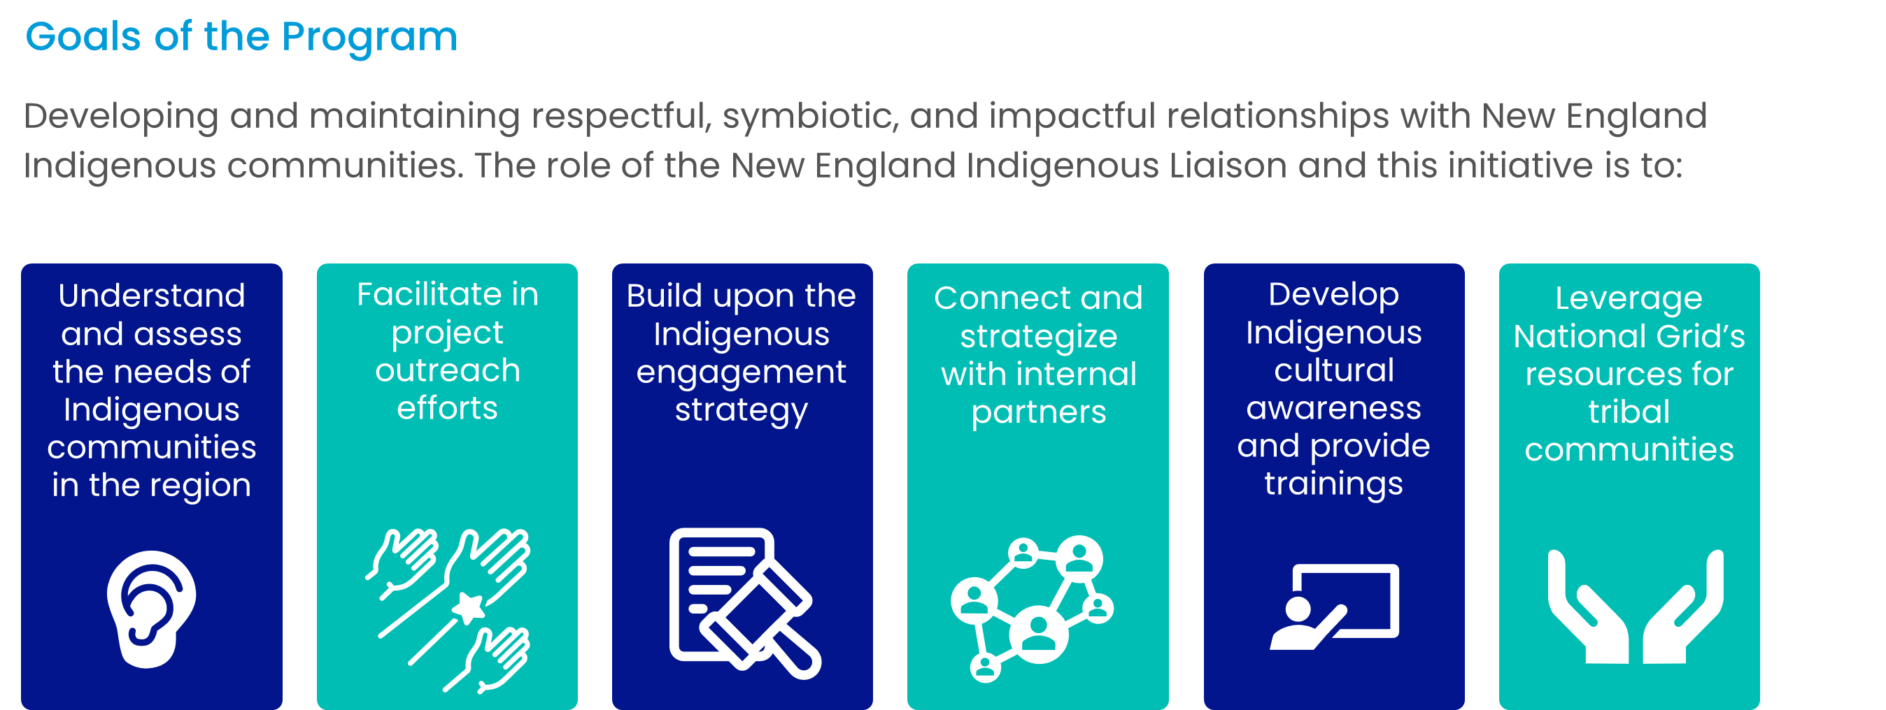
National Grid
Indigenous Peoples Initiative 2024
Indigenous
Peoples
Feedback
Questionnaire
First Nations ERG Mission Statement
2024
Where We’re Going: Outlook for the Next Year
Looking ahead, our vision for the next year is both ambitious and focused on deepening our impact.
Website Launch: We are in the final stages of developing a dedicated website that will serve as a hub for all our Indigenous initiatives. This platform will provide easy access to resources, updates on our activities, and opportunities for engagement.
Newsletter Introduction: To keep our tribal stakeholders informed, we plan to introduce a newsletter that will highlight our ongoing projects, upcoming events, and stories from the communities we serve. This will ensure that our communication remains consistent and transparent.
Expanded Sponsorships: We aim to increase our sponsorships for Powwows and other cultural events. These sponsorships not only support the preservation of Indigenous traditions but also provide us with valuable opportunities to engage with community members in a culturally meaningful way.
Growing Our Reach: We are committed to expanding our reach into Native communities throughout our service territories, building on the relationships we’ve established and seeking new opportunities to partner with more Native Nations.
National Grid’s Indigenous engagement and outreach initiative has transformed significantly over the past year. From a place of initial uncertainty, we have grown into a trusted partner, deeply embedded in the communities we serve. As we look to the future, our commitment remains steadfast: to empower, collaborate, and celebrate the rich heritage and potential of Indigenous peoples across our service areas.
Goals of the Indigenous Peoples Initiative
Developing and maintaining respectful, symbiotic, and impactful relationships with New England Indigenous communities. The role of the New England Indigenous Liaison and this initiative is to:
First Nations ERG Mission Statement 2024
The mission of the First Nations ERG is to promote diversity and inclusion by supporting the career progression of First Nations People and fostering awareness of cultural and traditional values among our employees and communities. Consistent with those First Nations values, we strive to protect and honor Mother Earth and all her gifts by championing sustainability and environmentalism and taking action against climate change. We invite all employees, including First Nations colleagues and allies, to join us in this important work.

