Slide 1
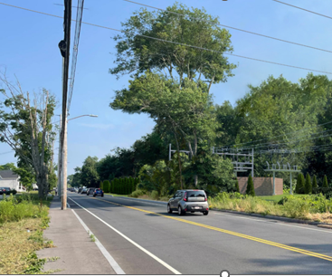
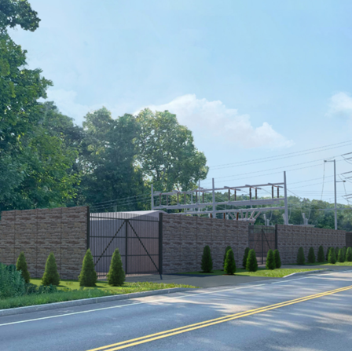
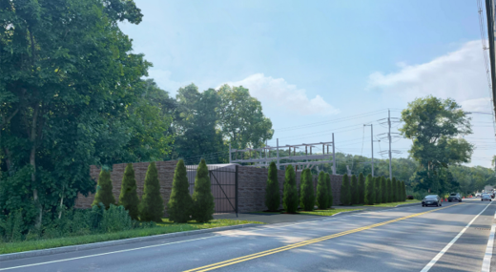

Taunton County Street Substation Project
  Open House

Slide 2

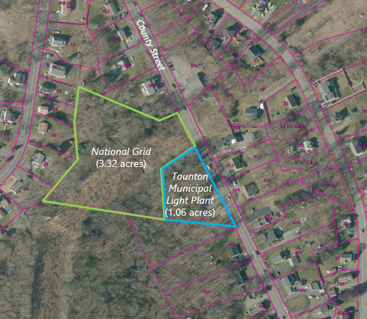
Project Overview​
Taunton County St Substation Project
Location: County Street, Taunton, MA
      (Map 79, Lot 71 and 242)
Project: New Substation and Transmission Tap Lines
Objectives:
    Address electric supply capacity issues
    Support current and projected load growth
    Ensure reliable power supply for customers

Slide 3
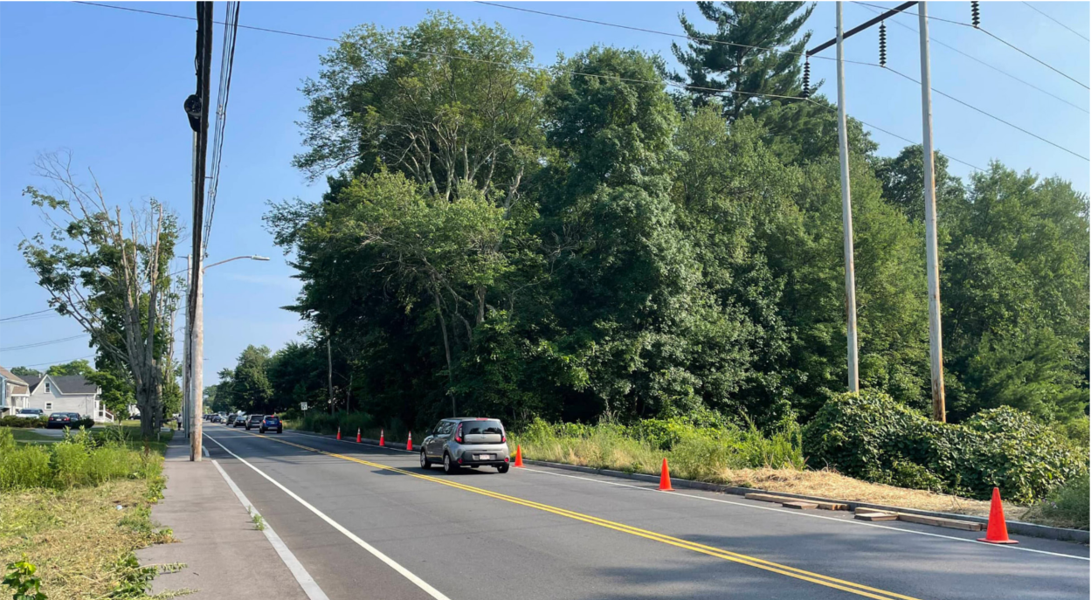
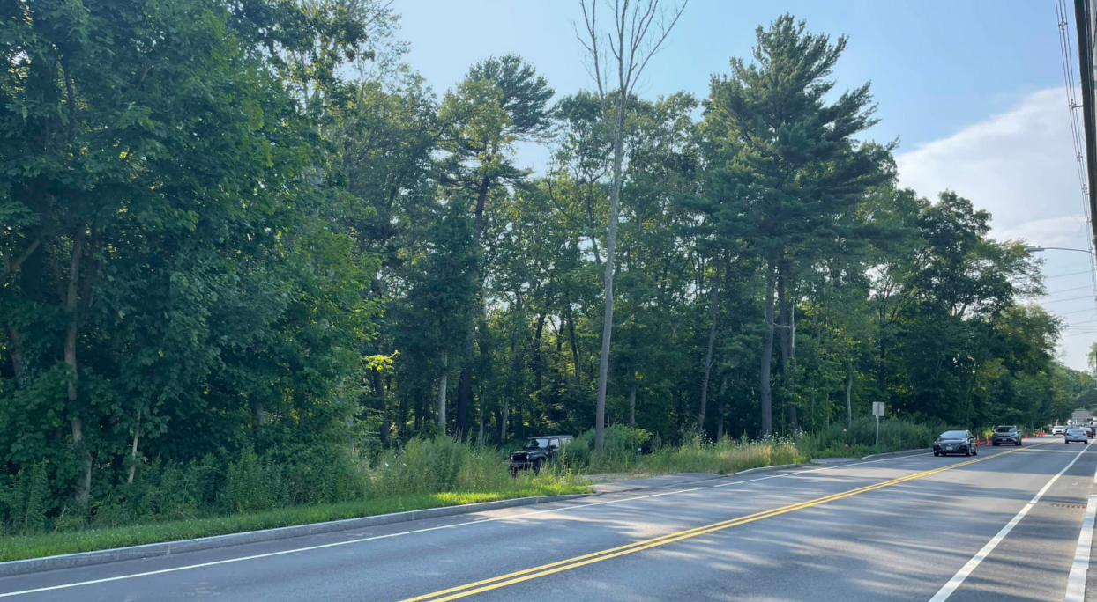
Visual Impacts
Existing Conditions
View Looking South
View Looking North

Slide 4
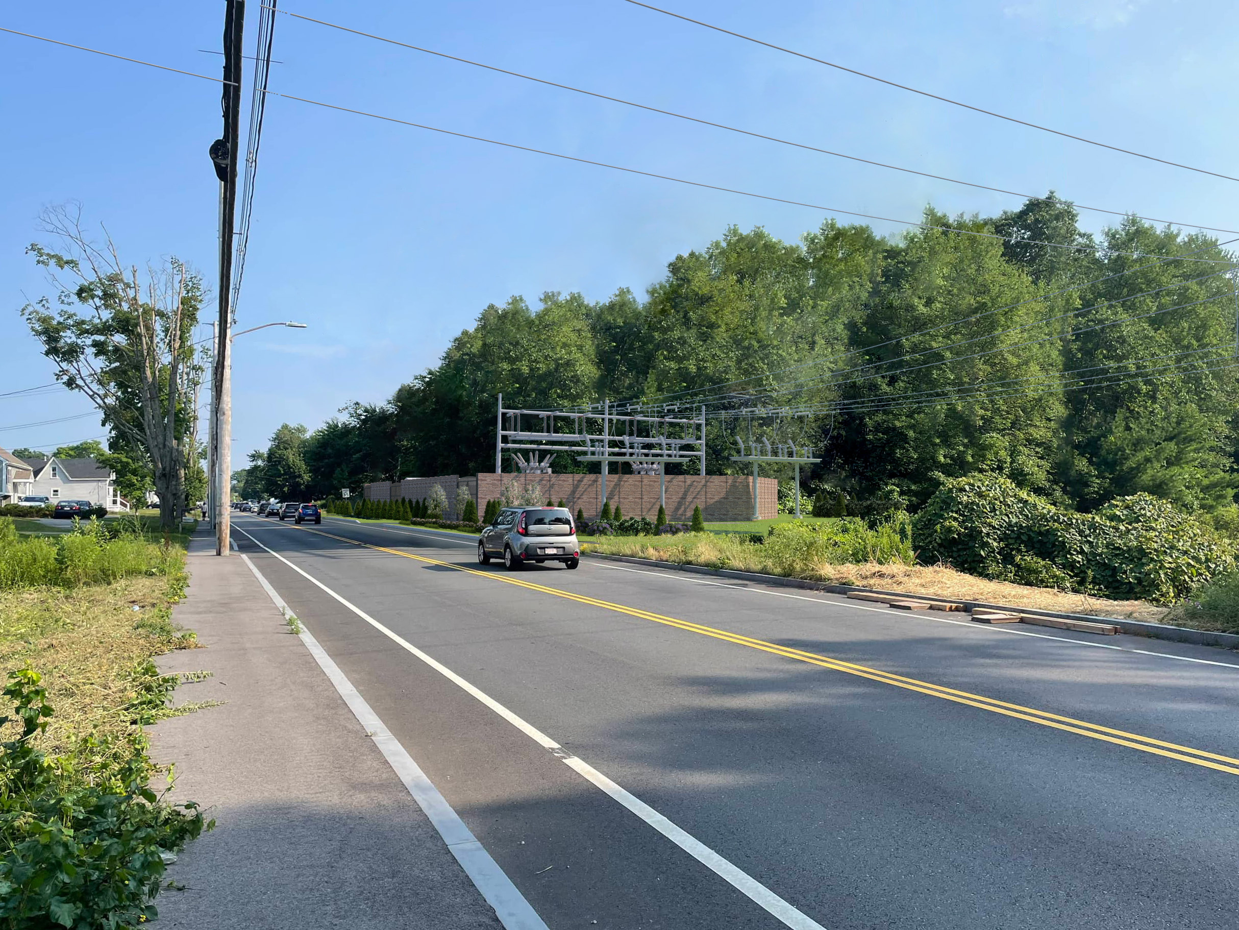
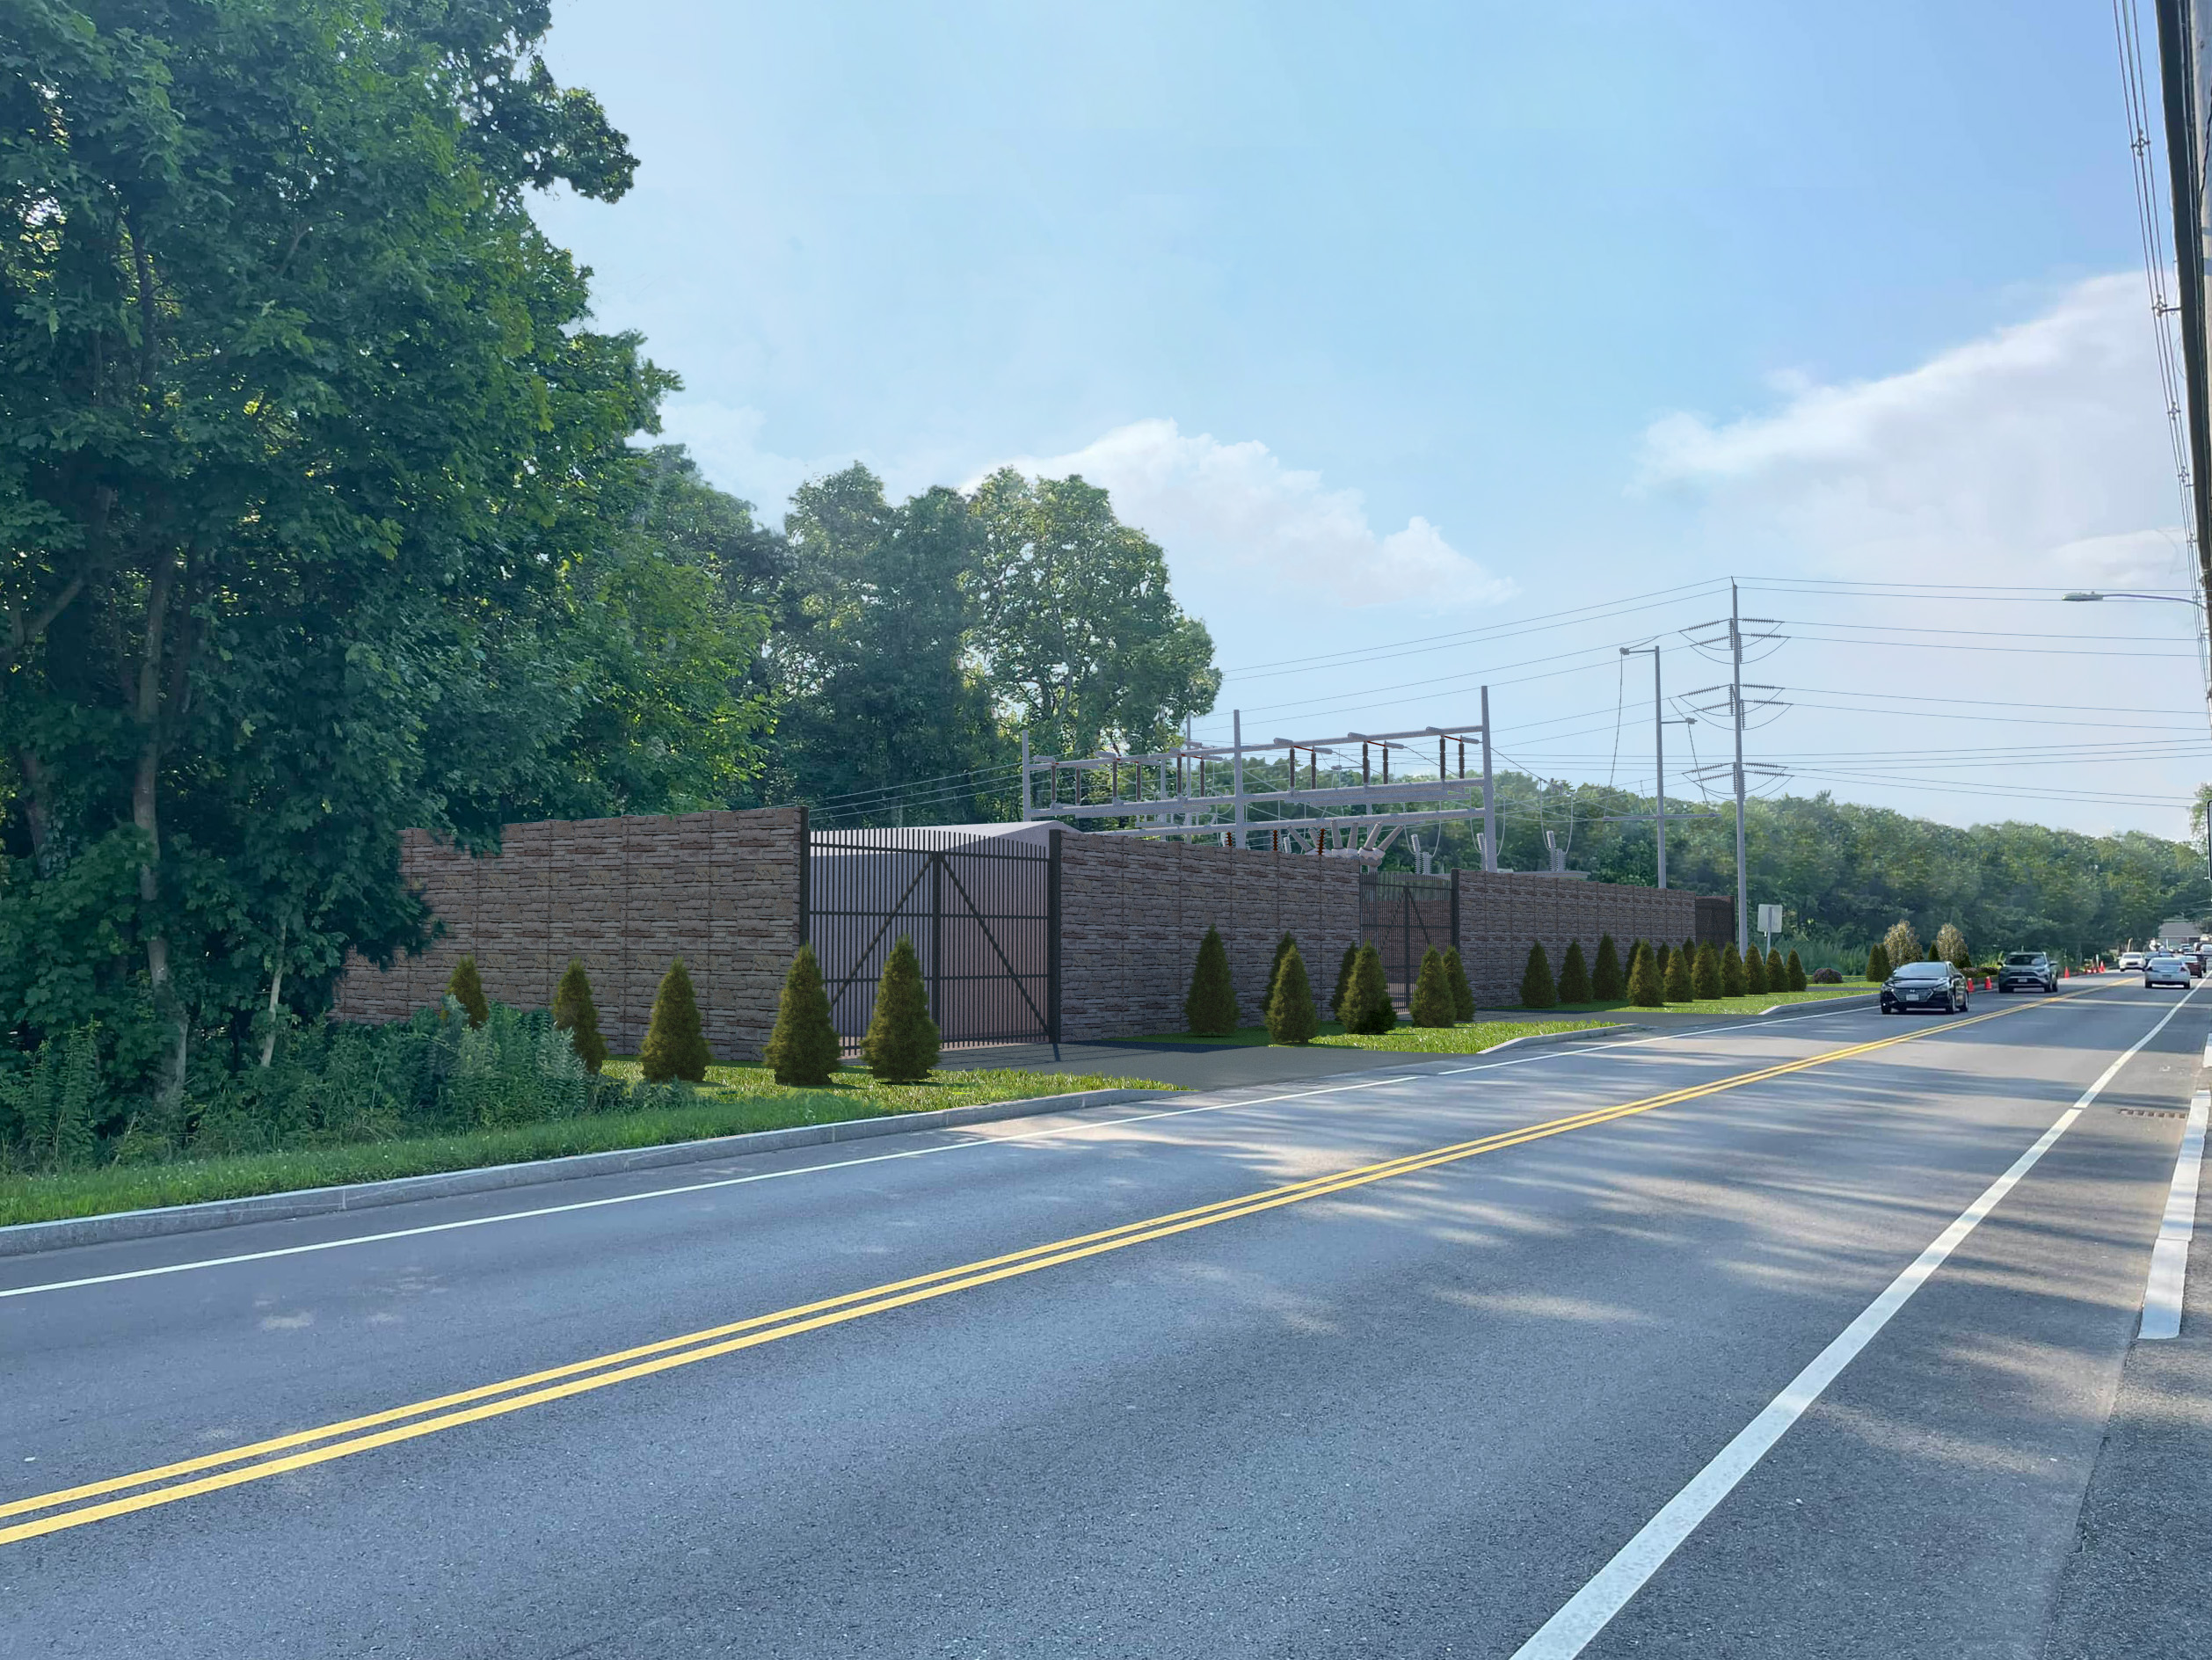
Visual Impacts
Proposed Conditions (Year 0)
View Looking South
View Looking North

Slide 5
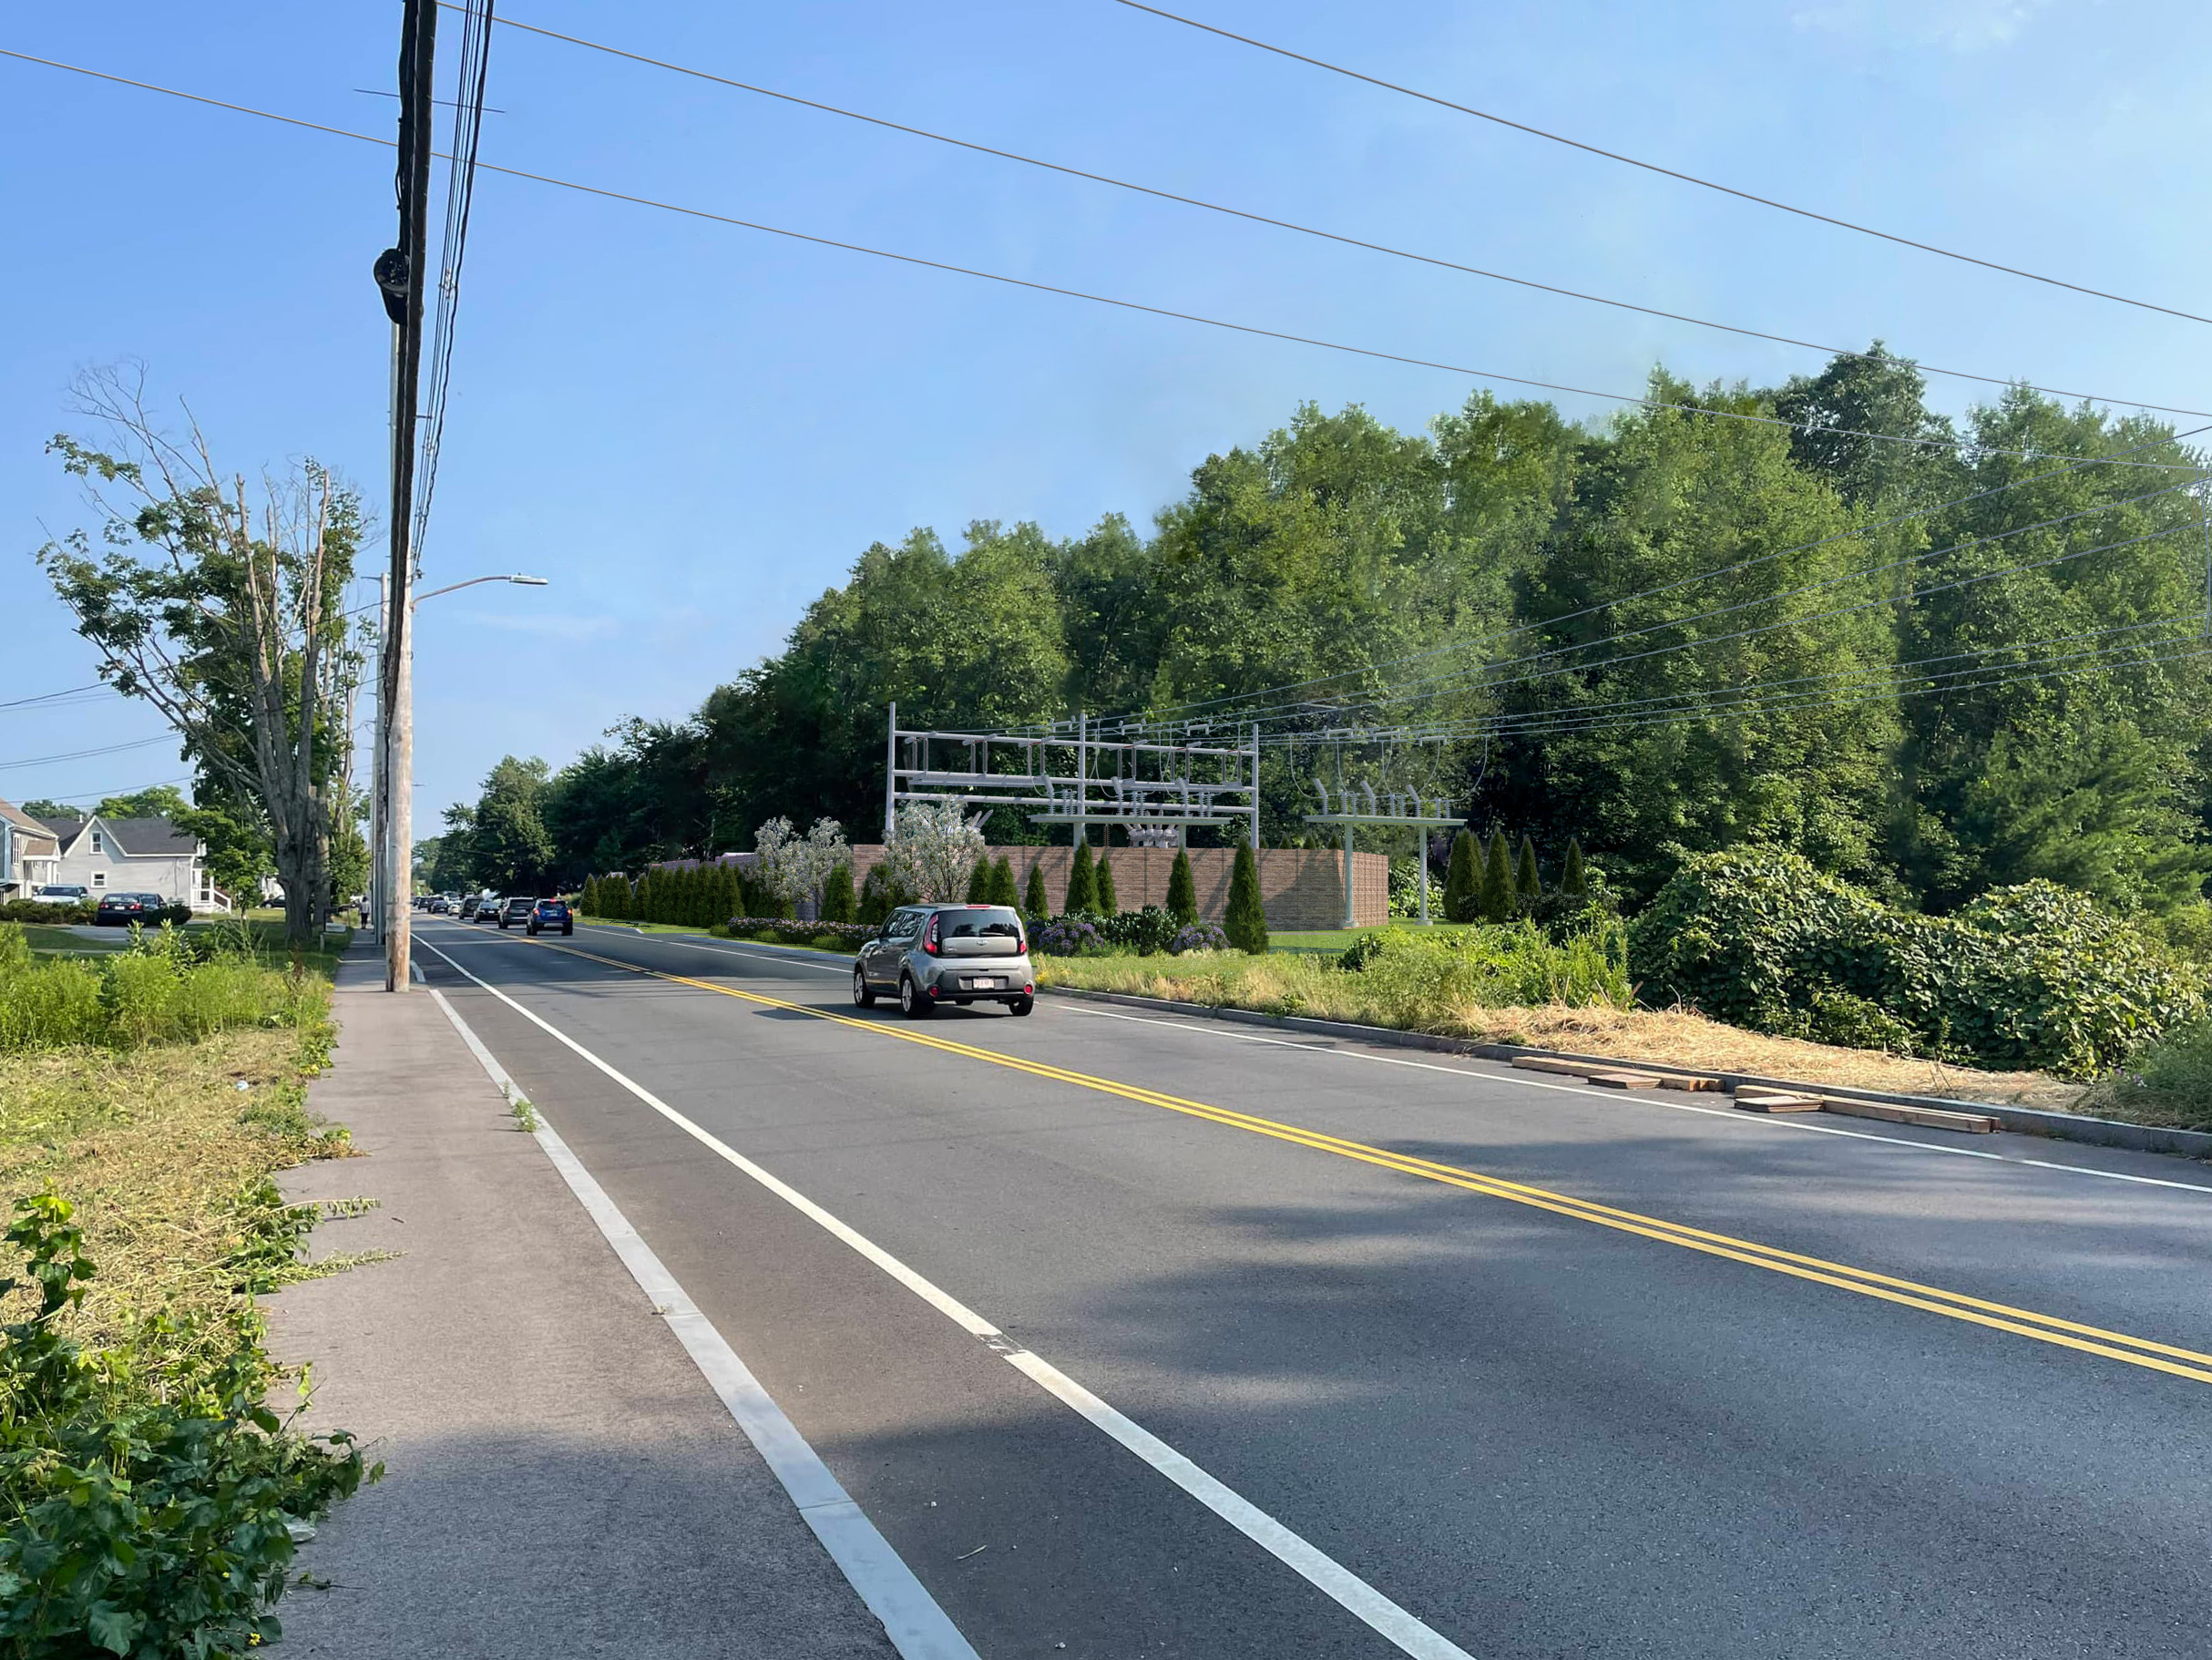
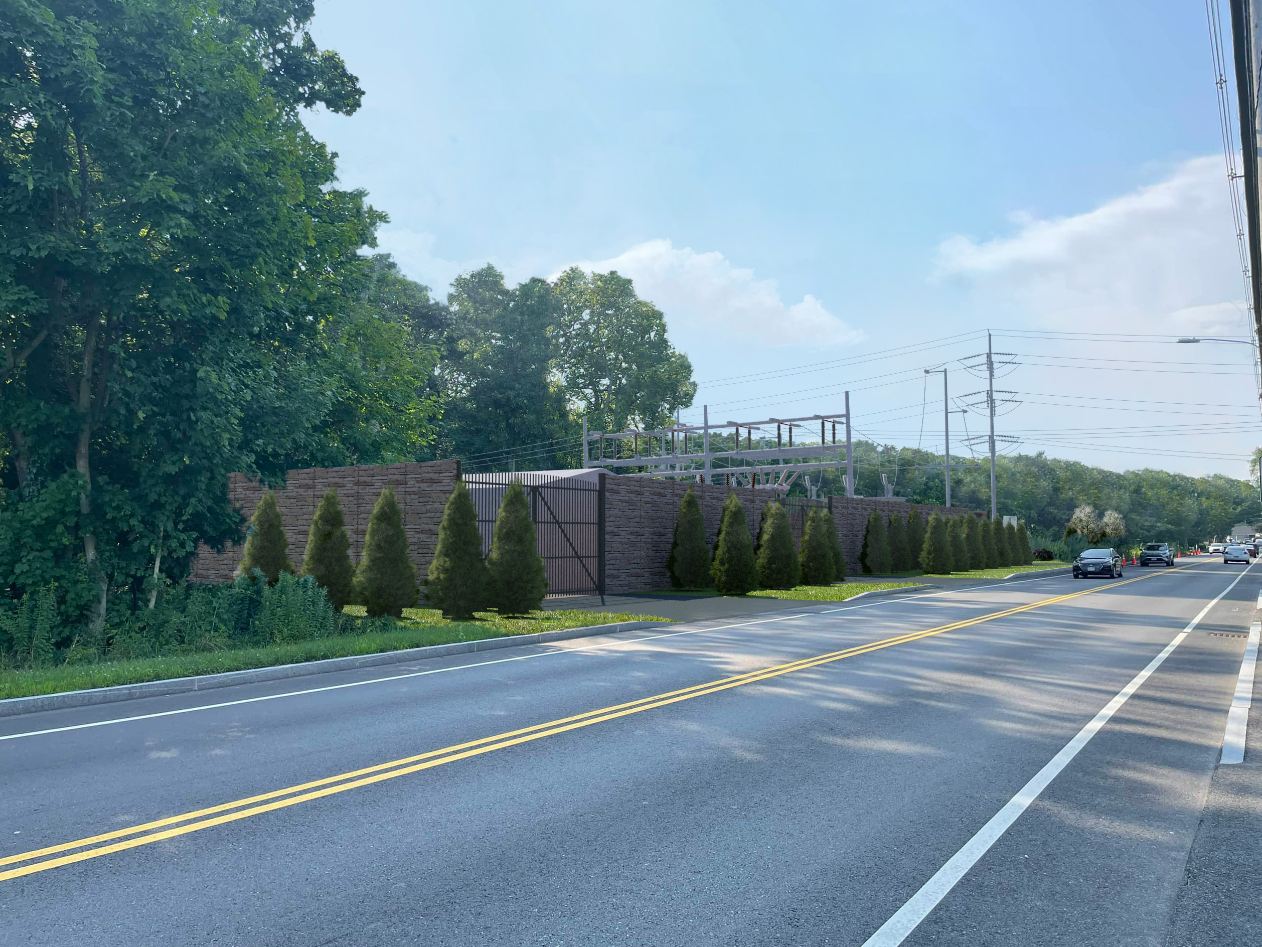
Visual Impacts
Proposed Conditions (Year 5)
View Looking South
View Looking North

Slide 6

Planning and Permitting Process
*Permits Subject to Change
Planning Process - TMLP
Project proposed by TMLP in 2012
System Impact Study done to determine the feasibility of the proposed project to interconnect to the electric grid
Regulatory Approvals – ISO NE (Independent System Operator New England)
Infrastructure improvements made in 2020 in preparation for the project and coordinated with the City of Taunton in conjunction with the City street upgrades.
Federal and State Environmental Permitting (not all inclusive):
  EOEEA – MEPA Review
  DEP – 401 Water Quality Certificate
  DEP - Wetlands Protection Act - Order of Conditions
  U.S. Army Corps of Engineers – Section 404 General Permit
  NPDES NOI (National Pollutant Discharge Elimination System Notice of Intent)
Local Permitting:
Taunton Conservation Commission - Wetlands Protection Act Order of Conditions

Slide 7

Project Schedule​
*Dates subject to change​
Stakeholder Outreach: Winter 2024/2025 - Ongoing​
Fact Sheet, Notifications, Postings on TMLP Website, etc.​
Field Assessments: Spring 2023 - Ongoing​
Construction Reviews, Environmental Field Work, Land Survey, Access Reviews, Cultural Resource Testing, Soil Borings​
Vegetation Management: ​
Prior to Construction: Summer 2026
Permitting: 2024 to 2026
Includes federal, state and local reviews​
Construction and Restoration:
Construction Start: Summer 2026
Construction Complete: Summer 2028

Slide 8
Public Outreach and Community Involvement​
TMLP Webpage:
https://www.tmlp.com/
Direct email:
CountyStreetSubstationProject@tmlp.com
Project Hotline:
781-236-6286
​All inquiries will be brought to both TMLP and National Grid project team members for input. We strive to respond to inquiries within 3 business days.
Massachusetts Environmental Policy Act Website:
https://www.mass.gov/orgs/massachusetts-environmental-policy-act-office

Slide 9
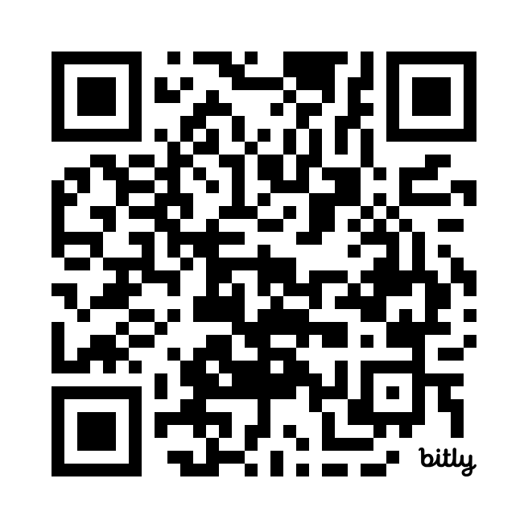
Somerset to Bridgewater Reliability Project
The V5 U6 S8 Transmission Line
What: The Somerset to Bridgewater Reliability Project will refurbish approximately 20 miles of 115kV overhead transmission lines and poles with new light duty galvanized steel structures. The existing transmission lines were originally constructed in the 1920s and 1950s. National Grid will be investing significantly in the Project to strengthen the region’s electrical transmission system.
Where: Somerset, Swansea, Dighton, Berkley, Taunton, Raynham, Bridgewater, MA
When: Summer 2024 to Winter 2030
Please use the QR code to visit
the project website.
Project Website: https://www.nationalgridus.com/construction-projects/Community-Projects/Somerset-to-Bridgewater-Reliability-Project/

Slide 10
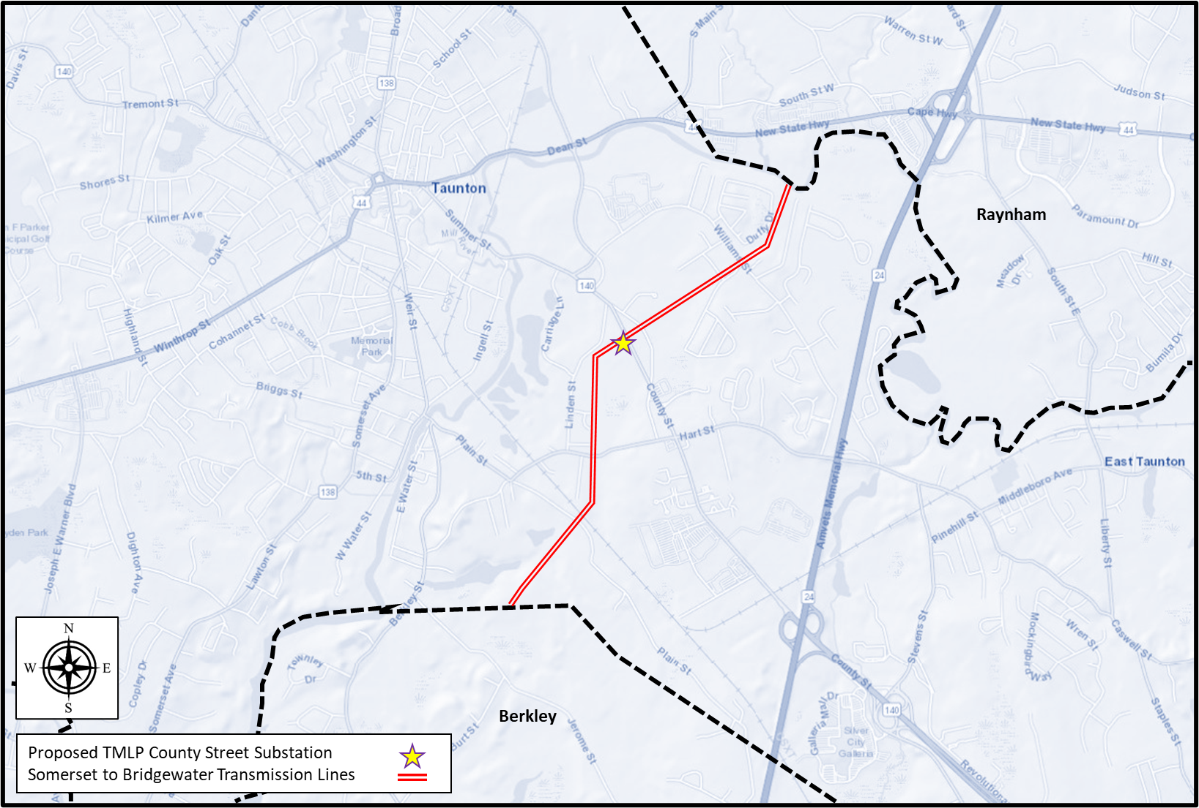
Somerset to Bridgewater Reliability Project - Project Route through Taunton

Slide 11

Thank You​
For more information, please visit or reach our Public Outreach team at: ​
Dedicated Project Hotline:781-236-6286 Email: Bethany.Rocha@NationalGrid.Com
Notes:
Thank you

