Slide 1
C203/D204 Reconfiguration
Part of the Fifteen Mile Falls Project
New Hampshire Site Evaluation Committee
Grafton County Public Information Session
Littleton Community Center
April 30, 2024
6 – 7 PM
Notes:
ADD NOTES BELOW TO TRACK CHANGES

Slide 2

AGENDA
  Scope of Presentation
  C203/D204 Project Map
  C203/D204 Project Scope
  Environmental Considerations
  Public Participation in SEC Process
  Community Outreach
  Questions & Answers Session

Slide 3
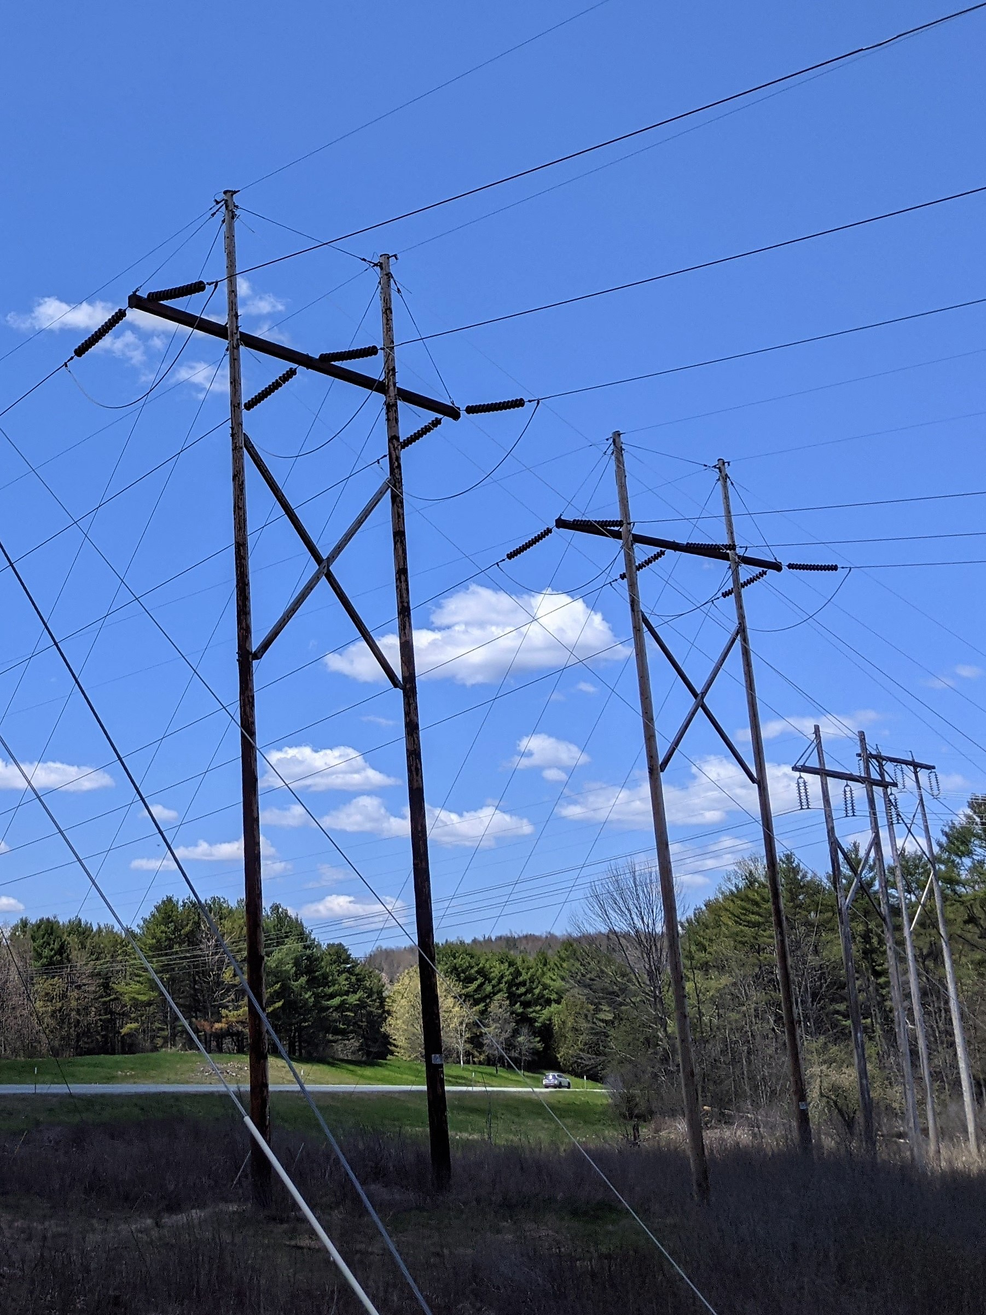
SCOPE OF PRESENTATION
  Fifteen Mile Falls Project Overview
  National Grid is undertaking the Fifteen Mile Falls Project in Littleton, New Hampshire. The purpose is to separate electrical transmission assets owned by National Grid from the electrical generation facilities owned by Great River Hydro while also upgrading aging infrastructure.
  The Fifteen Mile Falls Project includes the construction of a new substation and related transmission line work.
  C203/D204 Reconfiguration – NH SEC
  The portion of the Fifteen Mile Falls Project we are here today to discuss is the C203/D204 transmission line reconfiguration (C203/D204). The scope of work includes relocating a small portion of the existing 230 kV C203/D204 transmission lines to serve the new substation. This is the only portion of the Fifteen Mile Falls Project that is subject to the jurisdiction of New Hampshire Site Evaluation Committee.
  National Grid will go through separate State and local approval processes for the construction of the substation.

Slide 4
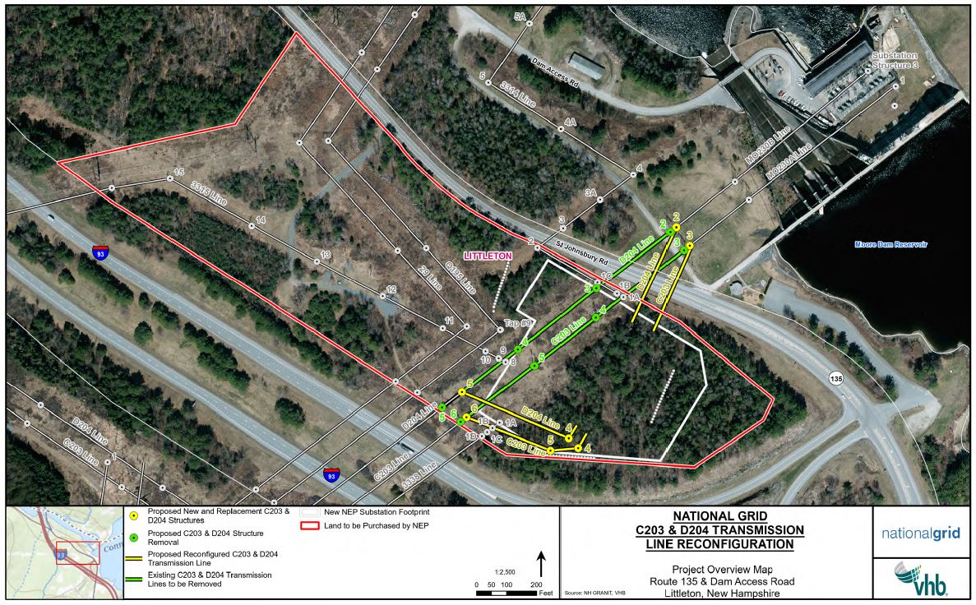
C203 D204 PROJECT MAP
line

Slide 5
C203/D204 PROJECT SCOPE
line
  Length
  National Grid is proposing to reconfigure approximately 800 linear feet of the existing C203 and D204 230 kilovolt (kV) transmission lines to serve a substation owned and operated by National Grid, to the southwest of the existing Moore Dam and its existing substation facilities.
  Structure Scope
  The C203/D204 Reconfiguration involves the construction of 7 structures and the removal of 1 structure:
  C203: 2 new structures and 2 replacement structures
  D204: 1 new structure, 2 replacement structures, and 1 structure removal
  The structures will be a combination of steel single pole and H-frame
  The structures will be between 70 and 90 feet
  C203/D204
  Estimated start date: Q1 2026

Slide 6
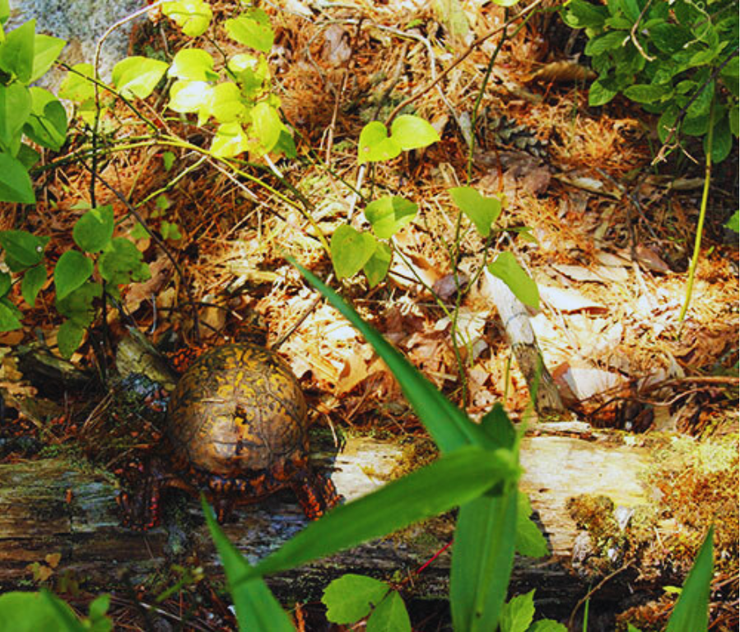
ENVIRONMENTAL CONSIDERATIONS
  •National Grid is committed to conducting the C203/D204 Reconfiguration in an environmentally acceptable manner that will meet all the expectations of State regulators and mitigate long-term adverse impacts.
  •National Grid will work with State and federal environmental agencies throughout the C203/D204 Reconfiguration.
  •As part of the C203/D204 Reconfiguration, there will be some vegetative clearing. This clearing is limited to small areas where the relocated C203 and D204 lines will enter the new Fifteen Mile Falls Substation situated between NH Route 135 and I-93.

Slide 7
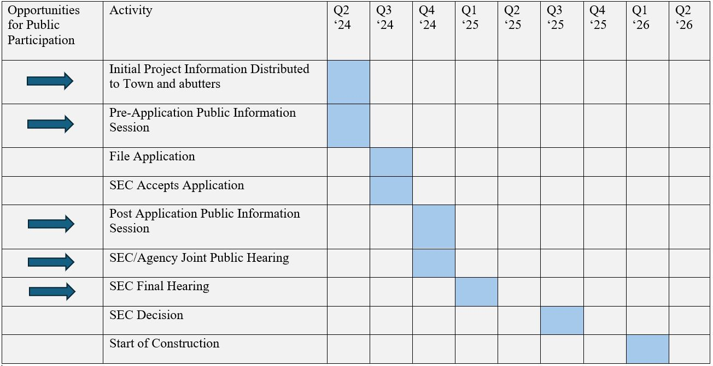
PUBLIC PARTICIPATION IN SEC PROCESS

Slide 8
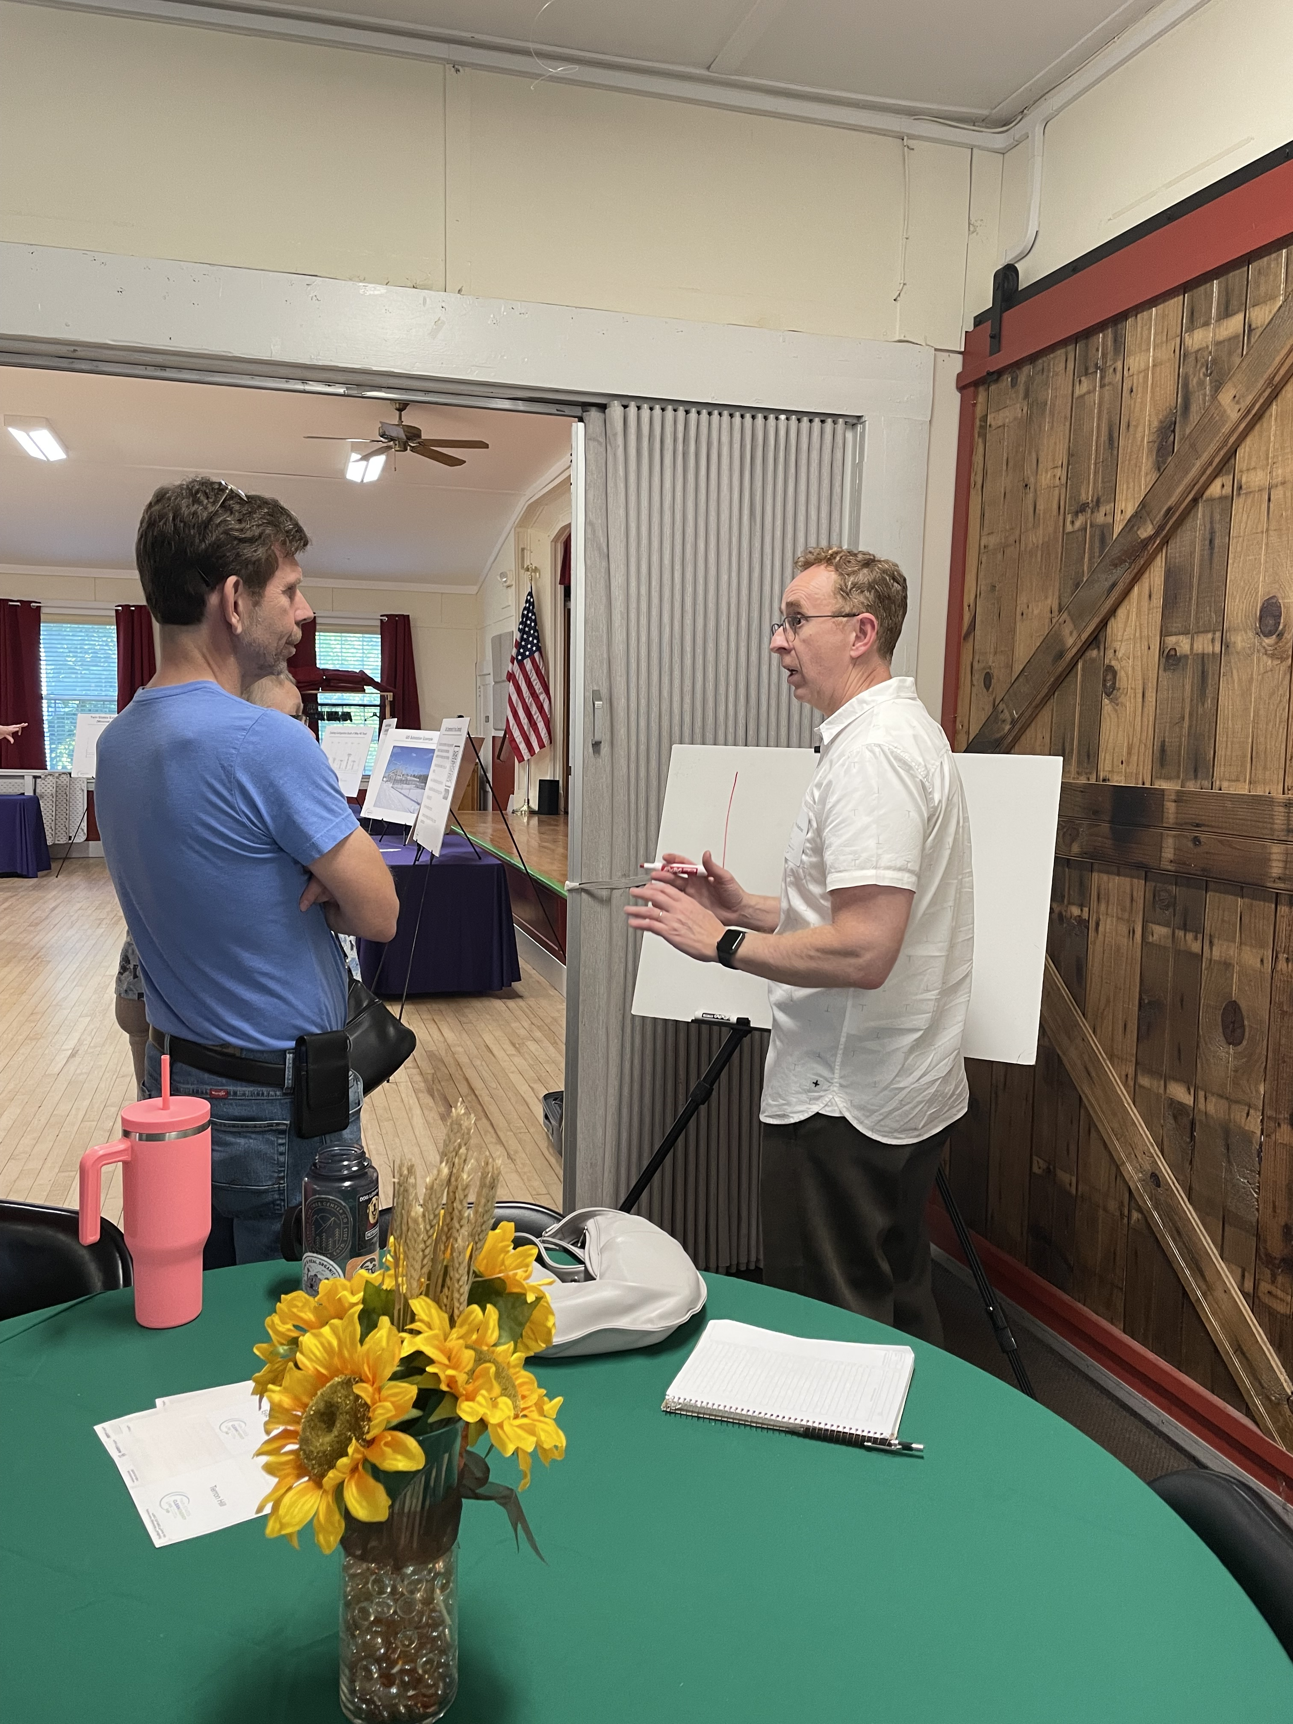
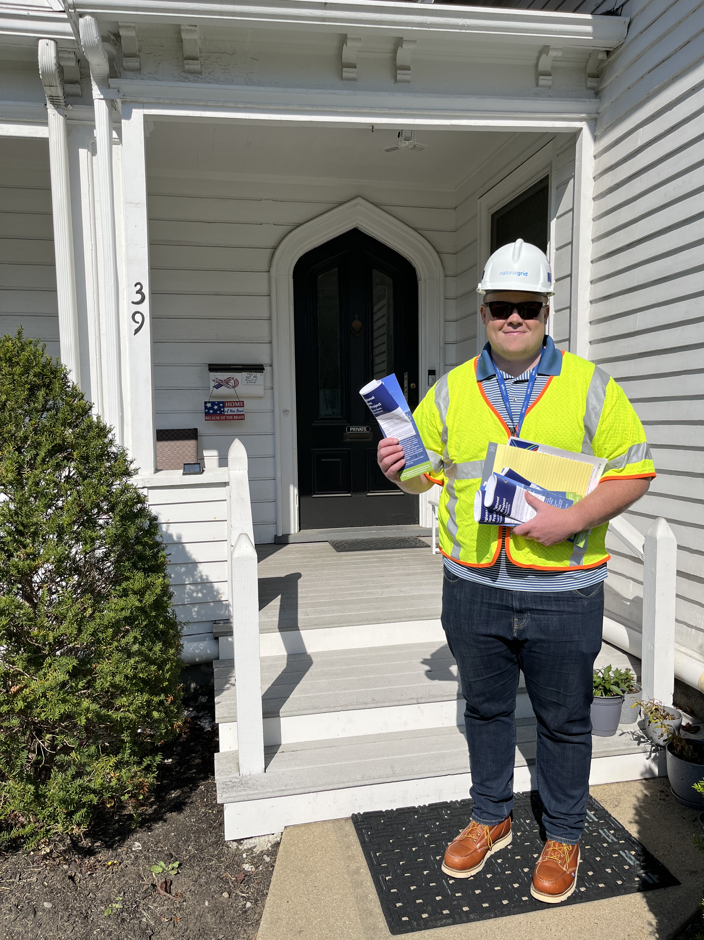
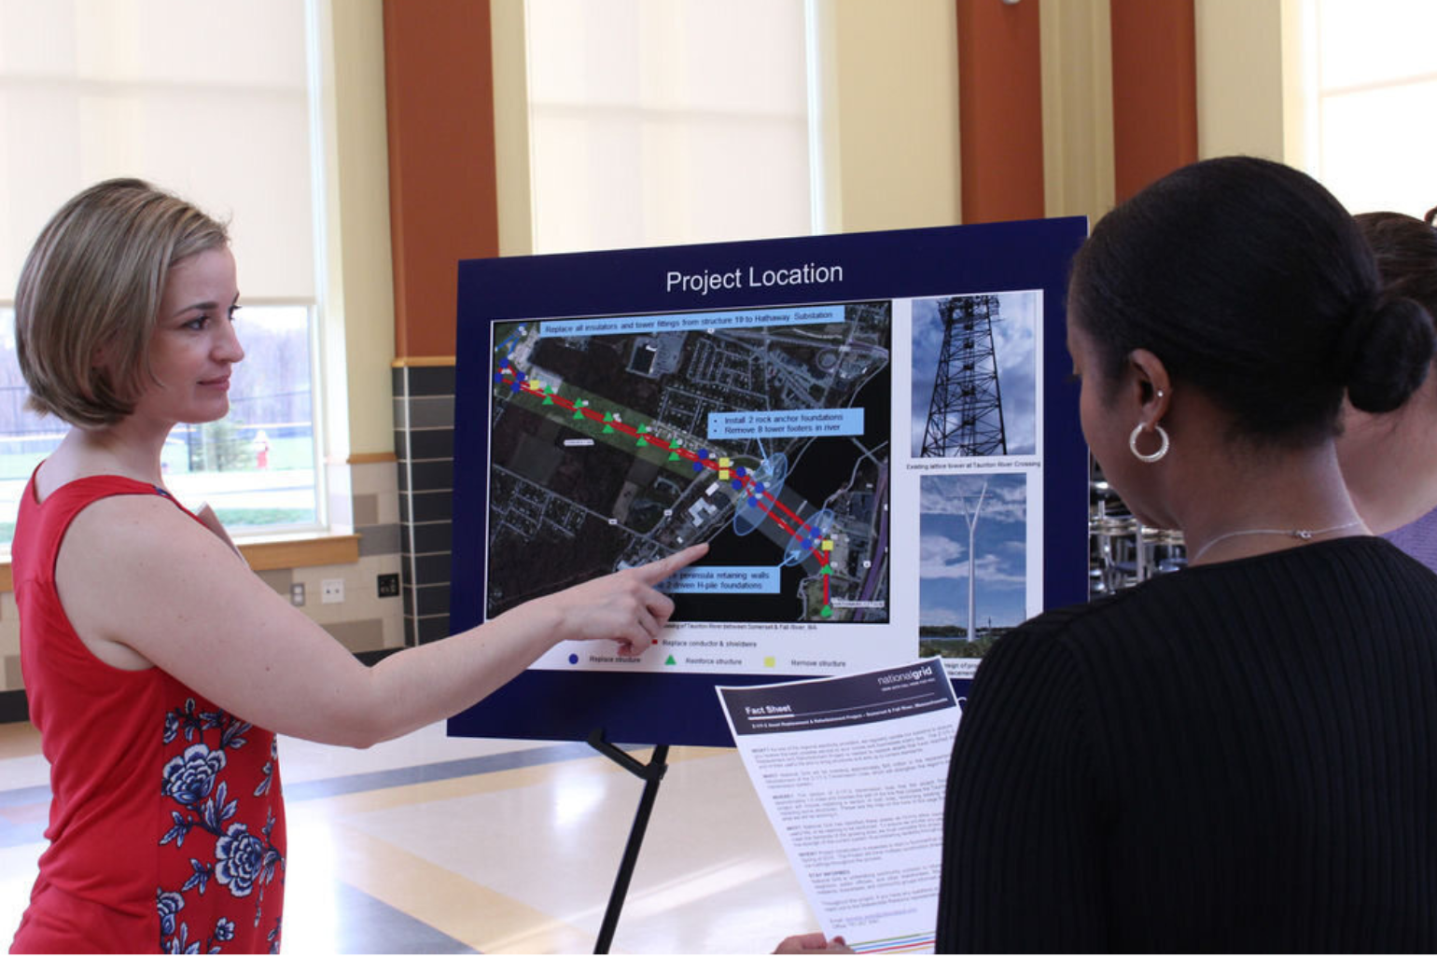
COMMUNITY OUTREACH
  We are committed to:
  Proactive, open, and regular communication
  Public education and information
  Value public participation in implementing our project
  Listen to and address community concerns and ideas
  Public Outreach:
  Fact Sheets
  Door Knocking
  Contact/Field Cards
  Letters
  Media/Press
    Local newspaper posts
    Community Center Calendar
  Open House Meetings for Substation Phase
    Meetings will be hosted starting Spring 2025
  Public Information Sessions for C203/D204
    One pre-filing session and one post-filing session
  Dedicated Website
    This Project website will be used to update project information and construction dates

Slide 9
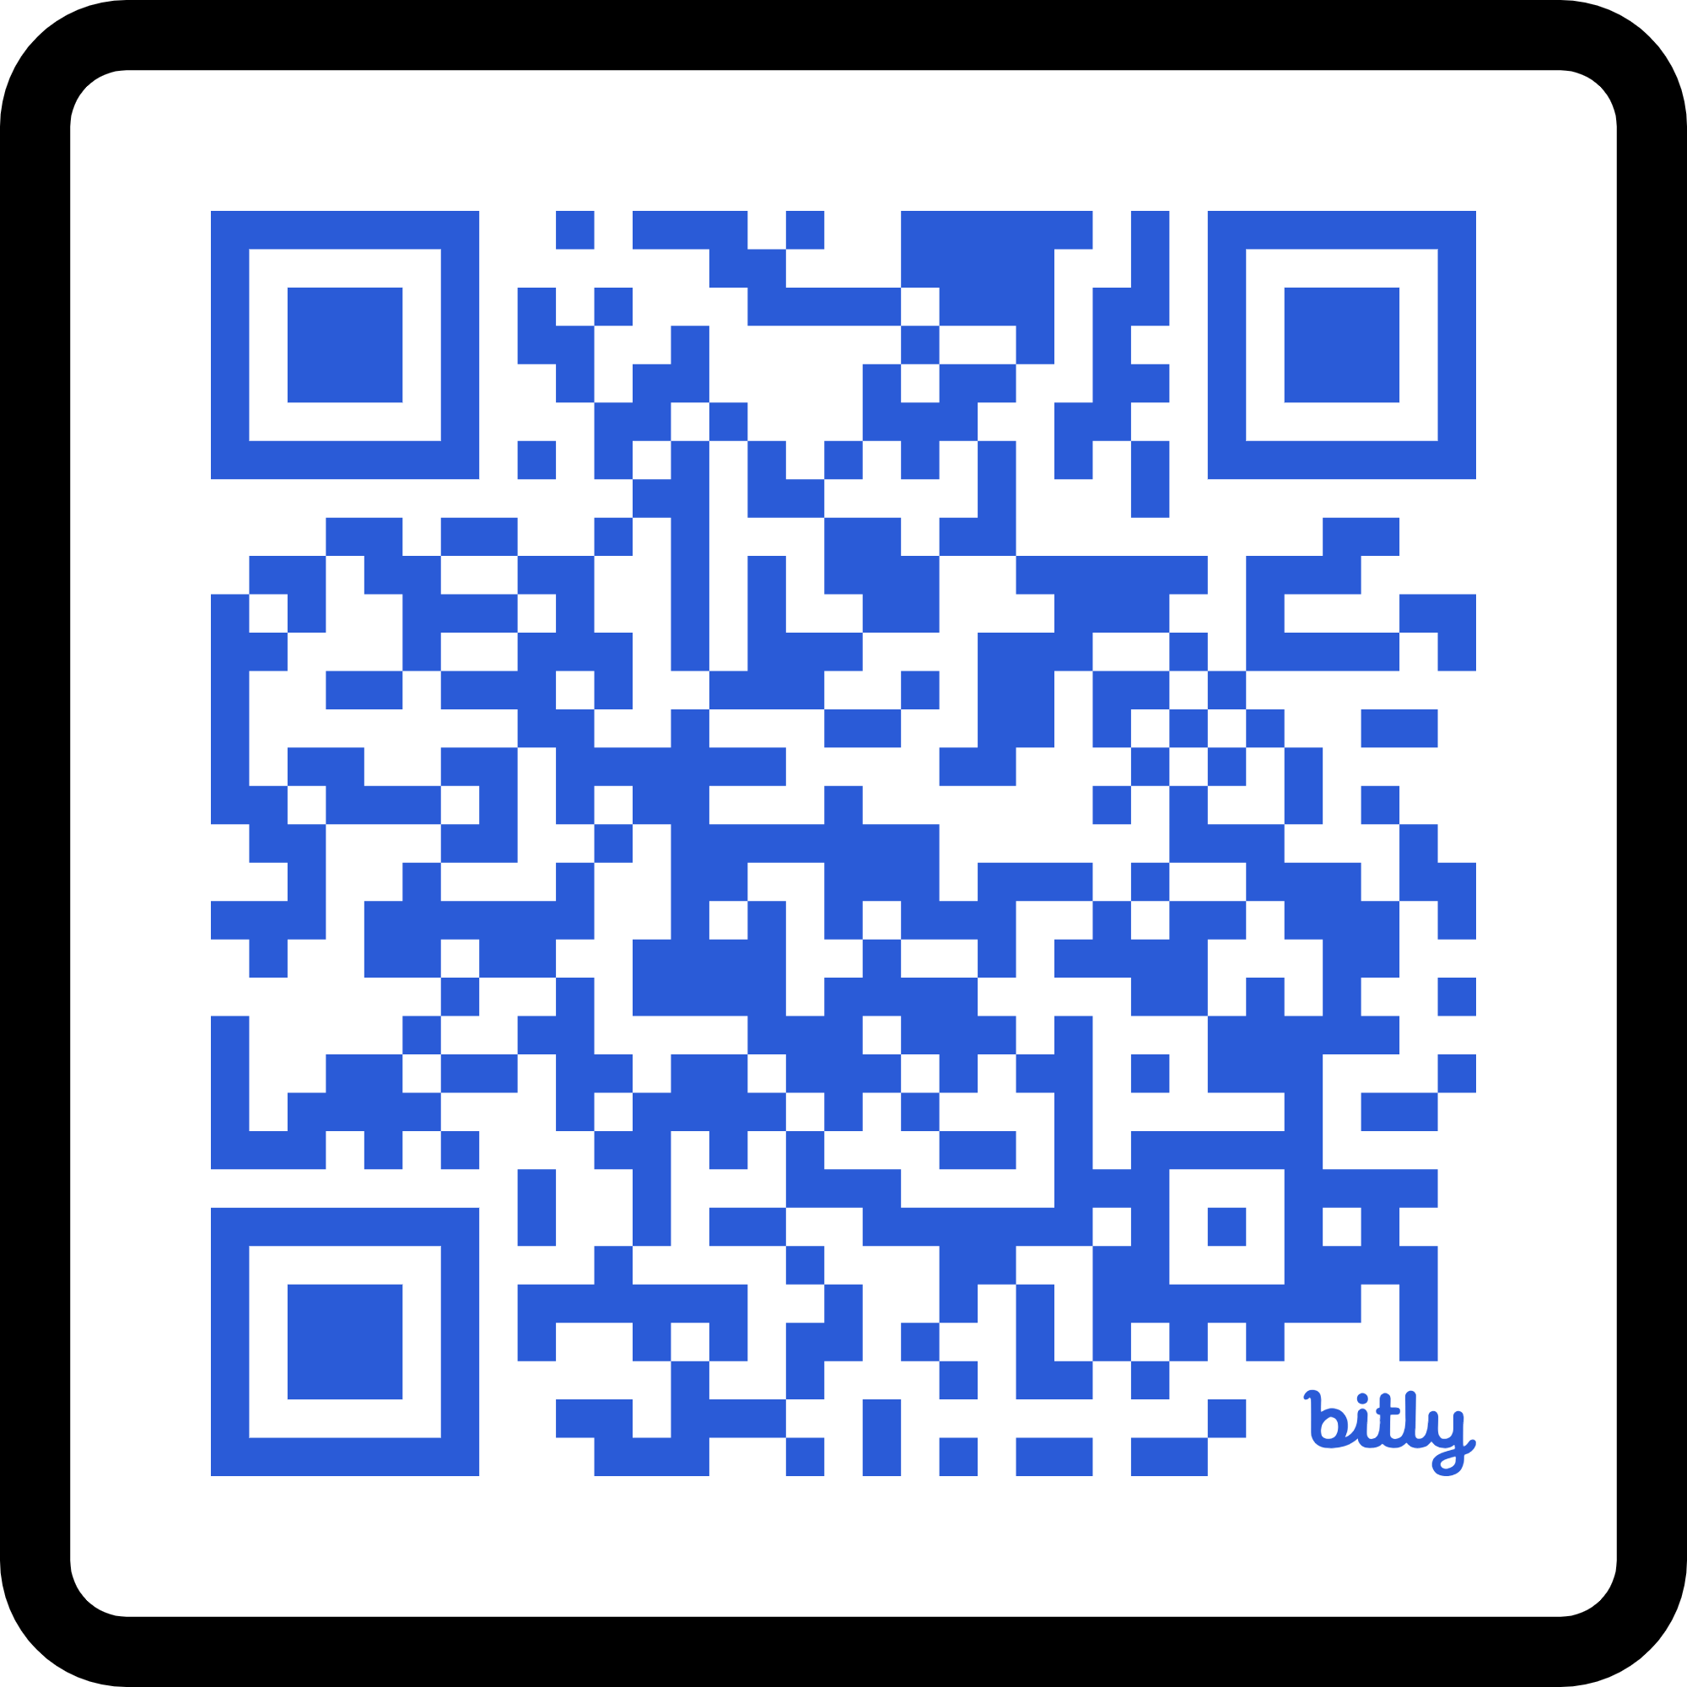
CONTACT INFORMATION
  Project Manager
  Logan Nunziato
  Lead Project Manager
  (781) 258-2535
  Logan.nunziato@nationalgrid.com
  Project Outreach
  Syrena Falkengren
  Outreach Specialist
  603.714.1685
  SFalkengren@watkinsstrategies.com
Project Website: Under Construction

Slide 10



QUESTIONS & ANSWERS SESSION
WE ARE HERE FOR YOUR FEEDBACK

